Slide 1
Albanian migration – between brain drain and remittances
Conference on international migration 14th February 2014 Economic Research Institute at BAS
Ilir GEDESHI – Center for Economic and Social Studies (CESS)

Slide 2
Albnian Migration
Source: CESS Migrant Questionnaire, 2009/2010
Fig. 1. First migratory experience and year of migration in current host country

Slide 3
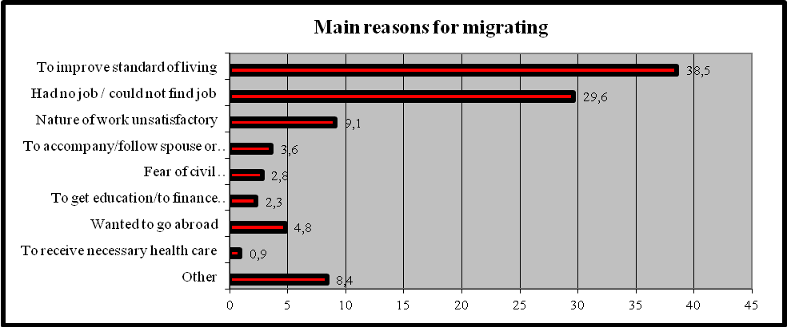
Albanian Migration/Push and pull factors
Source: CESS Migrant Questionnaire, 2006
Fig. 2. Main reasons for migrating in the 90’

Slide 4
Albanian Migration
Source: CESS Migrant Questionnaire, 2009/2010
Fig. 3. Employment sectors of Albanian migrants in host countries

Slide 5
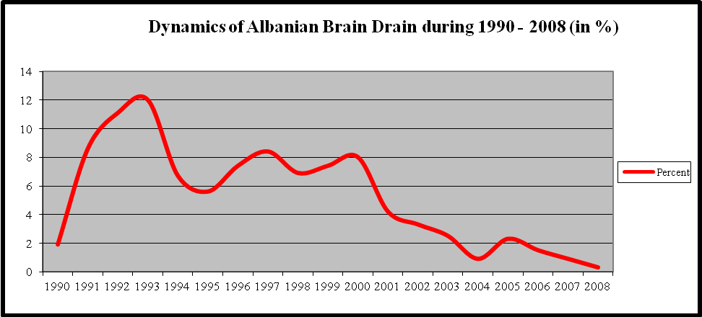
Albanian Brain Drain
Source: CESS, 2008
Fig.4. Dynamics of Albanian brain drain: share of Academics
moving abroad as % of total Academics (1990-2008)

Slide 6
Albanian Brain Drain
Source: CESS, 2008
Fig. 5. Albanian brain drain by the country of destination in 2008 (in percent)

Slide 7
Albanian Brain Drain
Source: CESS, 2008
Fig.6. Albanian Brain Drain by Country of Destination and Year of Migration (in %)

Slide 8
Diaspora Option
Source: CESS., Updating the database of overseas graduates, 2004
Fig. 7. Albanian academics and researchers working abroad by country

Slide 9
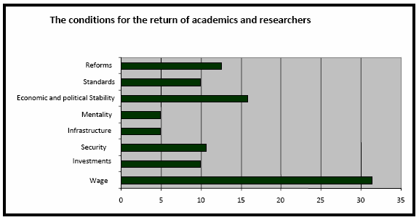
Brain Gain
Fig. 8. The conditions for the return of academics and researchers

Slide 10
Remittances
Source: Bank of Albania, 2014
Fig. 9. Volume of remittances in USD and Euros

Slide 11
Remittances
Source: Bank of Albania, 2014
Fig.10. Remittances to Albania as percent of GDP

Slide 12
Remittances
 | ALSMS, 2002 | ETF Study, 2007 | de Zwager et al., 2010
Investments | 12% | 11,8% | 10%
Table 3. Portion of remittances that is invested according to different studies

Slide 13
Remittances
Selected Data on Migrant Household (HH) Savings and Remittance Behaviour:
 | Albania | Kosovo | BiH**
Monthly HH Income: | € 2,300 | € 3,900 | € 2,288
Monthly Expenditures: | € 1,477 | € 2,324 | € 1,938
Monthly Saving Rate: | € 855 | € 1,578 | € 350
Annual HH Remittance Value: | € 1,664 | € 3,212 | € 1,752
Annual HH Savings Rate:* | € 10,260 | € 15,724 | € 2,448
Savings in 2008: | € 3,473 Million | € 2,340 Million | € 1,175 Million
Remittances 2008: | € 672 Million | € 479 Million | € 841 Million
Savings/Remittances Factor: | 5.2 | 4.8 | 1.4
* # Kosovar HH abroad: 149,000; # Albanian HH abroad: 404,000; Source: IASCI-NEXUS Field Research Dec-Jan 2008/9
** The above BiH-specific figures are speculative as they are based on a conservative extrapolation of incomes, expenditures, savings and remittances behaviours of BiH migrant HHs in Austria. # BiH HH abroad: 480,000 based on 2.5 persons per HH of an estimated total number of 1.2 Mio BiH migrants abroad. Source: IASCI-NEXUS Study 2009

Slide 14
Conclusions

